Slide 1
Shortlisting Assessment
50% - Plans for Fellowship
25% - Ambassadorship
25% - Style and Content of presentation

Slide 2
SSI International Pilot Fellowship application Meag Doherty
Submitted to SSI on ####
URL: XXX
Notes:
Intro
Hi, I am Meag Doherty,
a User Experience leader and
open-source community builder in the field of research software
based in the US.

Slide 3
Goal: Build capacity with RSE leaders to measure user outcomes in research software.
Notes:
For my SSI fellowship, I plan to build capacity with RSE leaders - at my home institution and abroad - to deliver a set of user outcomes metrics for research software

Slide 4
Goal: Build capacity with RSE leaders to measure user outcomes in research software.
User outcomes are signals about the user experience that RSE leaders can use to make better informed decisions.
Notes:
For my SSI fellowship, I plan to build capacity with RSE leaders - at my home institution and abroad - to deliver a set of user outcomes metrics for research software

Slide 5
The problem
When RSE leaders want to measure user outcomes, they
develop custom metrics based on individual project goals (and sometimes funder requirements),
rely on industry measurement tools,
do nothing ☹
These approaches can lead to
siloed, sometimes proprietary metrics,
data that makes a project look good but is not actionable,
and worse, vague feelings of success or failure.
Notes:
When RSE leaders want to measure user outcomes in research software, they tend to do one of the following: they develop custom metrics based on individual project goals (and sometimes funder requirements), rely on industry measurement tools that are in the business of nudging users to give up more data and/or spend more money, or sometimes they do nothing ☹
These approaches can lead to siloed, sometimes proprietary measures, data that makes a project look good but is not actionable, and worse, vague feelings of success or failure.
Given this hypothesis, there are a few driving question I plan to explore:

Slide 6
My hypothesis
IF RSE leaders had widely accepted user outcome metrics,
THEN RSE leaders could reduce errors, increase productivity, and build evidence-informed software.
Notes:
When RSE leaders want to measure user outcomes in research software, they tend to do one of the following: they develop custom metrics based on individual project goals (and sometimes funder requirements), rely on industry measurement tools that are in the business of nudging users to give up more data and/or spend more money, or sometimes they do nothing ☹
These approaches can lead to siloed, sometimes proprietary measures, data that makes a project look good but is not actionable, and worse, vague feelings of success or failure
Given this hypothesis, there are a few driving question I plan to explore:

Slide 7
Fellowship Approach
Listen
Document
Convene
Notes:
The approach to my fellowship is to learn, document, and develop awareness about the subject of measuring user outcomes in research software.

Slide 8
Fellowship Approach
Listen
Document
Convene
Attend events, trainings, and workshops:
DataSHIELD Conference
UKBiobank Annual Conference
Carpentries related to health research software
UK Health Data Research Alliance Symposium
Engage with communities and organizations:
Open Life Sciences
Turing Way
Genomics England
EMBL-EBI
Notes:
I plan to first listen and learn from the research software community.
During this phase, I will deepen existing relationships and contributions and establish new connections, through attendance at relevant events, trainings, and workshops AND engaging with communities and organizations.

Slide 9
Fellowship Approach
Listen
Document
Convene
Host a Collaboration Workshop:
At CW-22
The session could include:
Shared user goals for research software
Metrics used by RSE projects
Best practices for evaluating user outcomes
Notes:
Next, I plan to convene interested stakeholders to discuss key questions and begin documenting best practices and lessons learned from measuring user outcomes in research software.
One possible venue would be SSI’s Collaboration Workshop

Slide 10
Fellowship Approach
Listen
Document
Convene
Publish Findings:
Ten Simple Rules for Measuring User Outcomes in Research Software
Notes:
In follow-up to the discussions and findings, me and interested collaborators could put forth a publication 10 Simple Rules for Measuring User Outcomes in Research Software

Slide 11
Strengthening UK-US connections
Focus on improving UK capability,
Extend the work of …
Promote a UK-based approach abroad, and
Share key findings from UK-based approaches abroad including
US Government’s UX COP
Pistoia Alliance’s User Experience for Life Science
GUIs for research software by Diego Alonso Álvarez
UK-based open research software evaluation
Notes:
a few considerations specific to the International Fellowship Pilot:
Focus on improving UK capability:
I plan to build upon the work of GUIs for research software by SSI Fellow Diego Alonso Álvarez / Helps developers to better understand the importance of GUIs for research software and encourage them to lose their fear - or reluctance - to invest time creating them, .
and other similar efforts that I uncover during my Fellowship
Promote a UK-based approach abroad:
I plan to share key findings from UK-based approaches abroad including US Government’s UX COP of which I am a member, and Pistoia Alliance’s User Experience for Life Science
Potential challenges:
Experience with accommodating UK time zones with Open Life Sciences and Mozilla Experience with accommodating UK time zones, I am a fluent English speaker, and lastly, my current professional development budget covers some travel and conference attendance
How will the goals of your plans benefit the UK research community? For example, your plans might have a focus on:
Feeding in successful research software related initiatives/approaches from abroad into UK-based projects, ​​
Adding capacity to do particular tasks and to collaborate with UK-based teams, and
Promoting UK-based initiatives, projects or ways of working abroad.

Slide 12
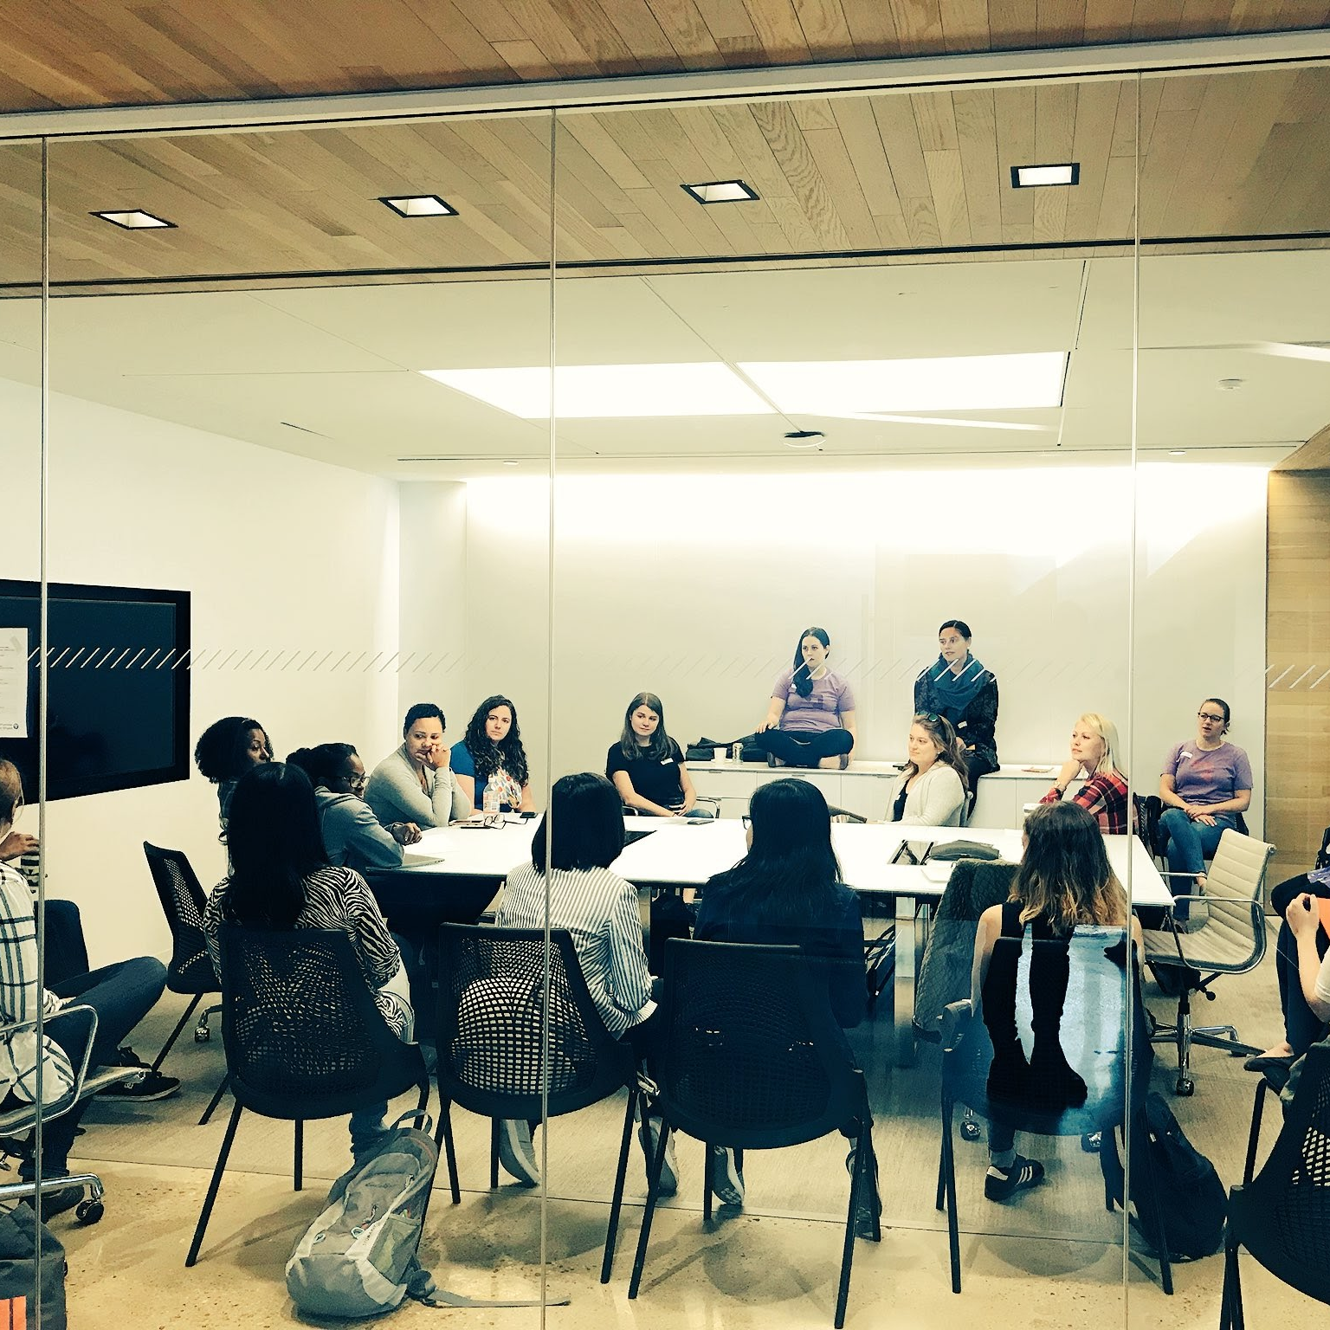
What I do
UX Strategy Lead, Data & Research
National Institutes of Health, All Of Us Research Program
Help program leaders identify ways to evaluate and measure user outcomes of research software.
Notes:
My current role is to lead UX strategy for research software at National Institutes Health’s All Of Us Research Program.
I have two key responsibilities: first is to help program leaders understand how to evaluate and measure user outcomes of research software. And second is to mature the user experience capacity of our program partners -- Broad Institute of Harvard and MIT, Verily Health and Life Sciences, and Vanderbilt University Medical Center.

Slide 13
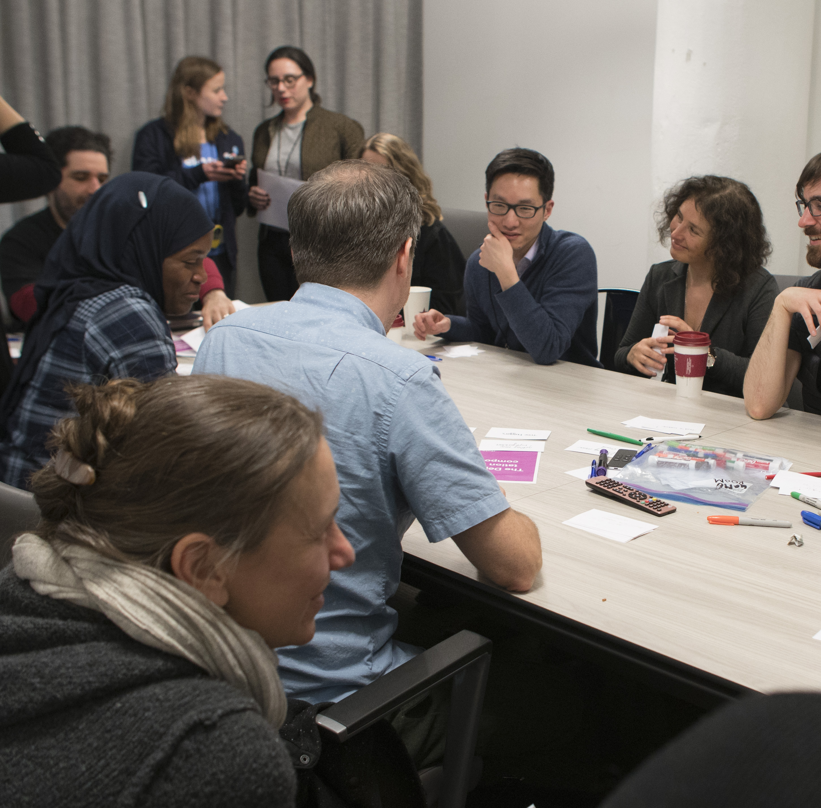
Who I am professionally
10 years in applied Health Sciences research and Public Sector innovation
Mozfest 2022 Space Wrangler
Mozilla Open Leaders Co-host (Cohort 7; Mentor, Cohort 6)
Open Life Sciences Mentor (Cohort 2,3,4)
Tech, Rebalanced, Co-Founder and Organizer
Educational and training background: public health and software design and development
Notes:
Professionally, I have 10 years of experience in health sciences and public sector innovation, including international civic engagement work with the Open Government Partnership.
In my volunteer time, I train and mentor open community members with Mozilla Foundation and Open Life Sciences. I am the co-founder and organizer for Tech, Rebalanced - an event supporting underrepresented genders and sexes in tech.
My work has been widely published in places like WIRED Magazine, MobiHealth News, and community forums including Mozilla Foundation’s Read, Write, Participate blog.
I am trained in public health policy and software design and development. Over the past 6 years, I have taken on increasing responsibilities in strategic management and leadership.

Slide 14
Thank You!
Acknowledgments
SSI Fellows: Diego Alonso Álvarez, Sarah Gibson, Malvika Sharan, Yo Yehudi

